Slide 1
Circuit Characterization
Interconnects and Inverters
Class 4
ECE 4140/6240
M.E. Zaghloul
Fall 22

Slide 2
Introduction
VLSI Design Parameters
- Speed
- Power
- Area
- Reliability
In this class we will learn how
- Estimate the Delay
- Estimate the Power
As the device size scales into the deep submicron, inter-chip wires will be very important parameters in the design

Slide 3
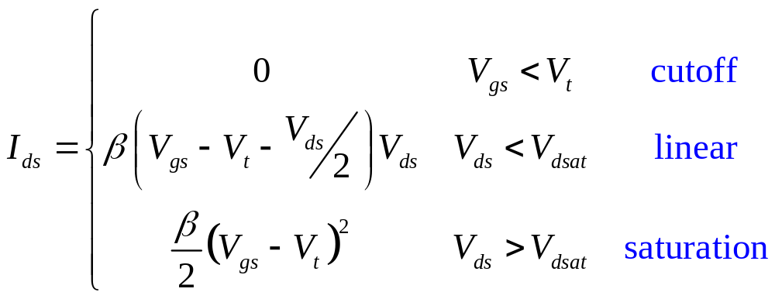
nMOS I-V Summary
Shockley 1st order transistor models
3: CMOS Transistor Theory

Slide 4
Non-Ideal Transistor Behavior
We Learned from last class that Non-ideal Transistor Behavior due to submicron size cause the following;
  High Field Effects lateral field between source and drain will cause
    Mobility Degradation
    Velocity Saturation
  Threshold Voltage Effects V_{t} is not constant
    Body Effect ϒ
    Drain voltage creates electric field that affects the threshold voltage
    For Short Channel the threshold voltage increases with channel length
  Leakage small amount of current when transistor I_{d} OFF
    Subthreshold Leakage
    Gate Leakage
    Junction Leakage
    In Addition to Environment Variations
Environmental Variations Temperature Dependence and Power supply variations , and Geometry dependence.

Slide 5
The wire- Interconnects
Chapter (4 in text)
It is important for the designer to have clear insight into the parasitic wiring effect
Each wire in the circuit is considered as conductor with parasitic capacitance, parasitic resistance, and parasitic inductor.

Slide 6
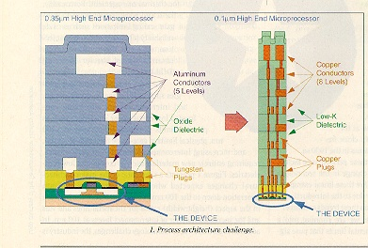
Interconnect Impact on Chip

Slide 7
Wire Models
All-inclusive model
Resistor, Inductor, and
Capacitor
Capacitance-only

Slide 8
Impact of Interconnect Parasitic
Interconnect parasitic
  reduce reliability
  affect the performance that is speed and the power consumption
Classes of parasitic
  Capacitive
  Resistive
  Inductive

Slide 9
RC Delay of the Interconnect and Inverter
We would like to calculate the parasitic R and C of the wire to estimate how much delay is in the wire. Delay is RC = Time
In addition we would like to estimate how much delay in the device (the transistor). This mean we have to estimate the effective resistance of the transistor and the parasitic capacitance

Slide 10
Simplification for the wire
Inductive effect can be ignored if the resistance of the wire is high, long wire with small cross section
For short wire with large cross section capacitance are important
Interwire capacitance are important when wires run in parallel for long distance

Slide 11
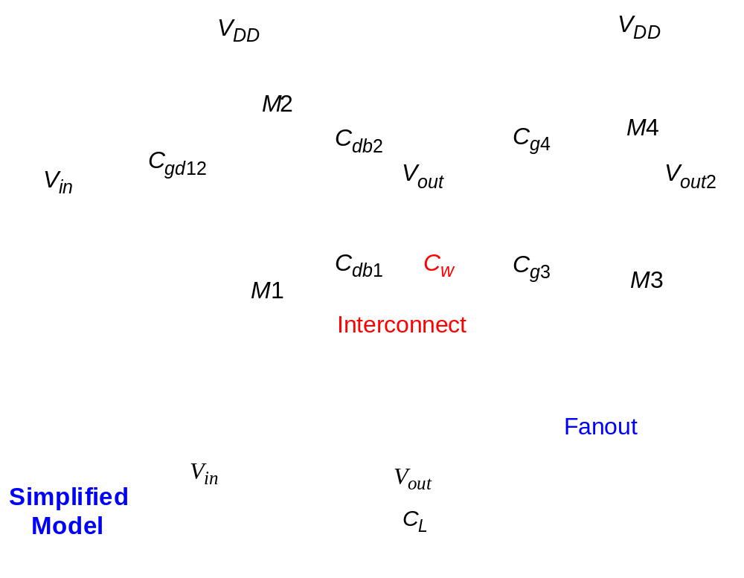
Capacitance of Wire Interconnect

Slide 12
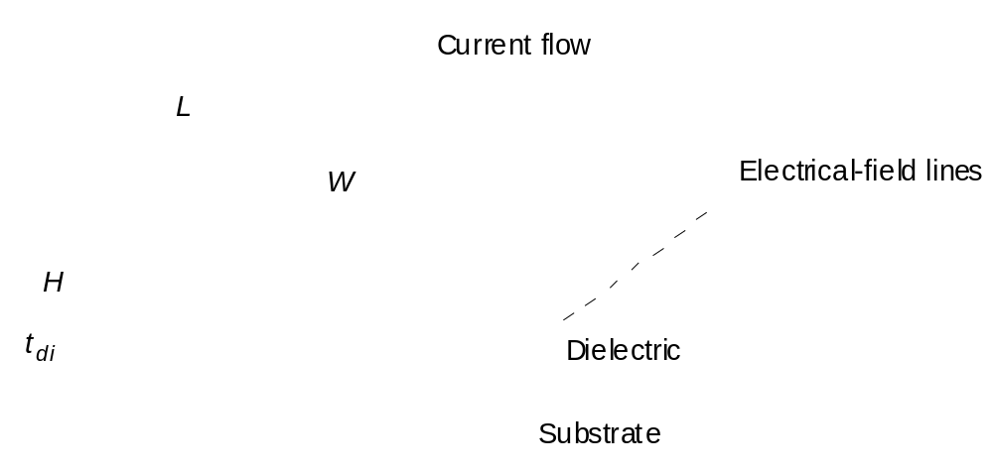
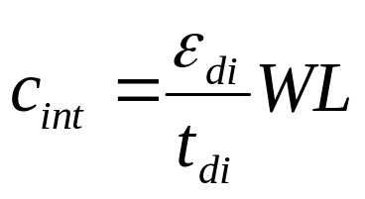
Capacitance: The Parallel Plate Model
Rectangular wire placed above semiconductor substrate
R = ρL = ρ L
A
W H

Slide 13
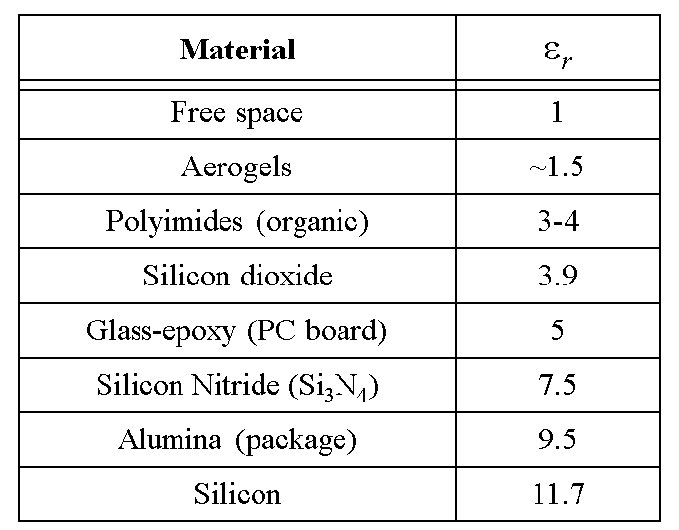
Permittivity
Different Materials

Slide 14
The Parallel Plate Model
Capacitances
Too simple for small ratio of W/H, the Parallel plate model is not accurate (As the dimensions are in Deep submicrons)
The Capacitance between the side wall can no longer be ignored “Fringe Capacitance” specifically at high frequency
The total capacitance is the sum of Parallel plate and Fringe

Slide 15
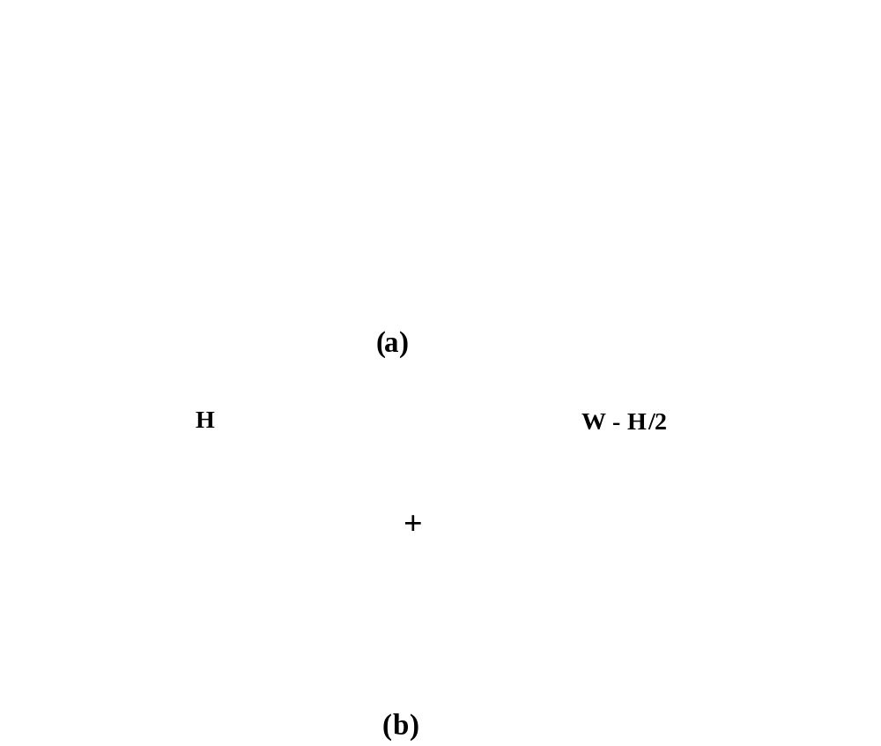
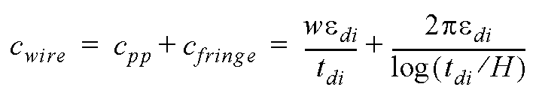
Fringing Capacitance
The model numerical (Approx.) decompose the capacitance into two components
Fringe
Cylinder Model
PP

Slide 16
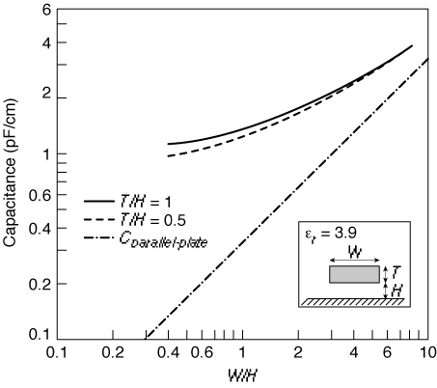

Fringing versus Parallel Plate
To Illustrate The Importance of fringe as W/H decrease
For W/H large PP dominate, while for W/H small Fringe dominate
C_{Fringe}

Slide 17
Capacitive Coupling
Each wire is not only coupled to the ground, but also to the neighboring wires on the same layer and on adjacent layers
This will affect the noise in the circuit and the performance of the chip

Slide 18
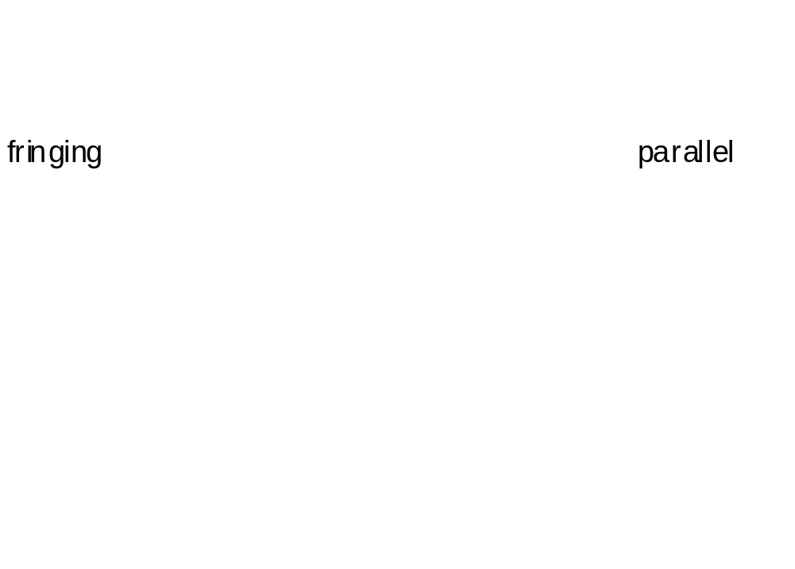
Interwire Capacitance

Slide 19
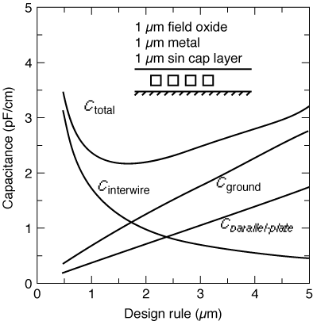
Impact of Interwire Capacitance
Interwire capacitance become a dominant factor in multilayers interconnect structures
As the technology scales

Slide 20
Wire Area and Fringe Capacitance Values
The following table shows 0.25 um CMOS process
The table rows represent the top plate of the capacitor
The columns represent the bottom plate
The areas are expresses in aF|um

Slide 21
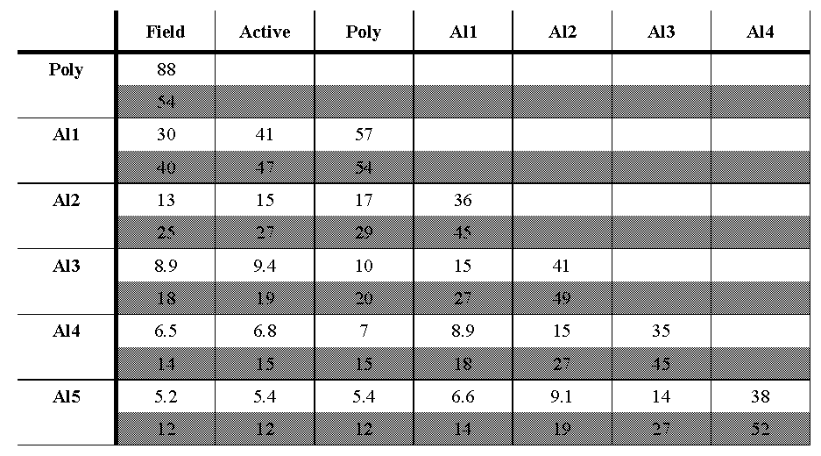
Wiring Capacitances (0.25 μm CMOS) in aF/um-page 143
Bottom Thick Field Oxide
Twice as thick as other metals
Shaded area are Fringe

Slide 22
Page 144 Rabaey example
4.1

Slide 23
Consider each element
The properties of Resistances
How to calculate the parameters of the Resistances

Slide 24
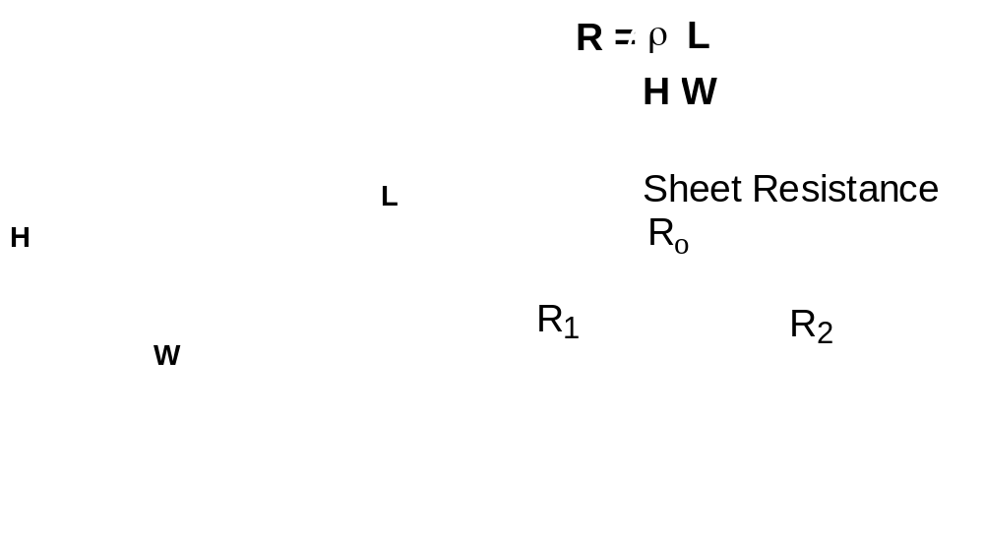
Wire Resistance
H is constant for a technology
Sheet resistance have units Ω/square
R = Sheet resistance * L/W = R_{s} L/W

Slide 25
Resistive Model of the wire
The model is too simplistic
To have the above model it is desirable to keep the cross section of the wire as large as possible to minimize the resistance( WxH)
To have denser wiring it is desirable to have smaller W
As result we have seen steady reduction of the ratio W/H

Slide 26
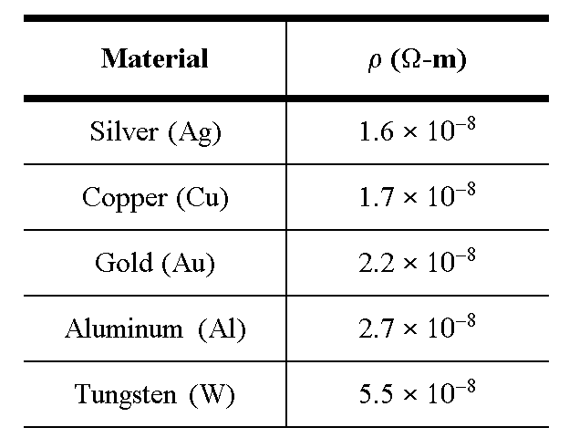
Interconnect Resistance

Slide 27
Dealing with Resistance
Selective Technology Scaling
Use Better Interconnect Materials
  reduce average wire-length
  e.g. copper, silicides
  Do-not Use Polysilicon for routing
More Interconnect Layers
  reduce average wire-length

Slide 28
Dealing with Resistance
Use of Diffusion wires should be avoided due to the large capacitances
Transitions between routing layers add extra resistance to a wire called contact resistance
Keep signal wires on a single layer whenever possible

Slide 29
Advanced Process
0.18, 0.13µ
Advanced Processes offer different material such silicide, high conductive material (Mixture of silicon and metal)
Gates of MOS are fabricated with top layer of Silicide to reduce the gate resistance
Recently Metal gate transistor

Slide 30

Polycide Gate MOSFET
Silicide
PolySilicon
SiO
2
n
+
n
+
p
Silicides: WSi
2,
TiSi
2
, PtSi
2
and TaSi
Conductivity: 8-10 times better than Poly

Slide 31
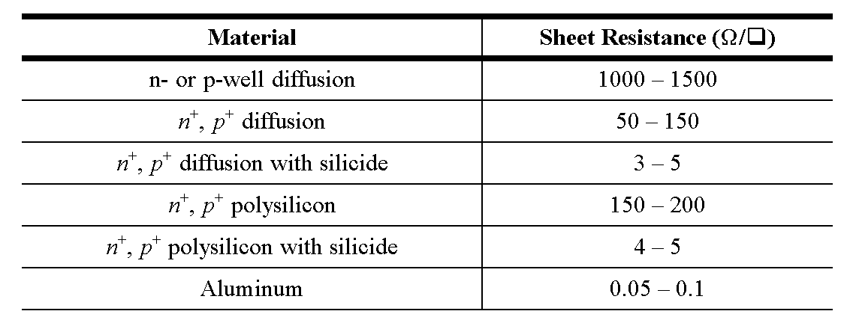
Sheet Resistance for Different layers

Slide 32
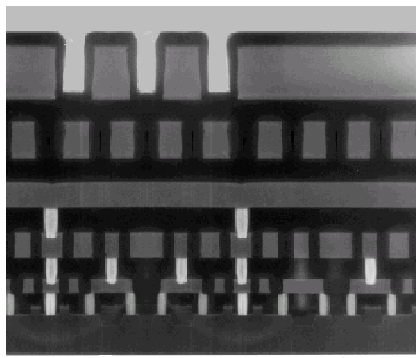
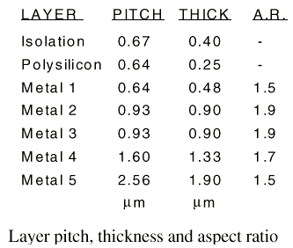
Example: Intel 0.25 micron Process
5 metal layers
Ti/Al - Cu/Ti/TiN
Polysilicon dielectric

Slide 33
Skin Effect
We have considered the resistance to be linear and constant
At high frequency the resistance becomes function of the frequency (skin effect)
High frequency current tends to flow primary on the surface of the conductor with skin depth δ.
Increase resistance
δ

Slide 34
Skin Effect
The skin depth is defined as the depth at which the current falls off to the value of e⁻¹
For aluminum at 1 GHz, the skin depth equals 2.6 μm
There is a critical frequency f_{s} below which the whole wire is conducting current.
Clock wires tend to carry the highest frequency, and are always wide to reduce resistance. Skin effect is likely

Slide 35
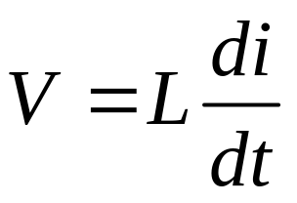
Inductance
The inductance is related to the voltage and the current by
A simpler approach is to relate cl = ε μ , where c is the capacitance per unit length and l is inductance per unit length ( this is derived from Maxwell), € is permittivity andµ is permeability

Slide 36
Inductance
The speed of propagation depends on the inductance and the capacitance and thus depends on the permeability and permittivity of the surrounding dielectric
Inductance is only an issue in integrated circuits at the high end of the performance curve

Slide 37
Electric Wire Modeling
In this section we will look at the equations of the wire and include parasitic
These parasitic elements have an impact on the electrical behavior of the circuit
The simple model of voltage change at one end will simply propagate to the other end is not applicable for small dimensions
Notice that we are trying to see the effect on the Speed

Slide 38
How To Model the Wire
Consider Distributed capacitance as shown in the figure
It can be Lumped as shown in the following example

Slide 39
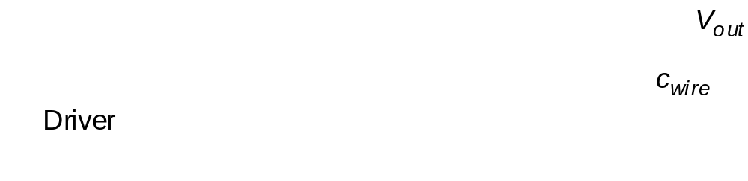
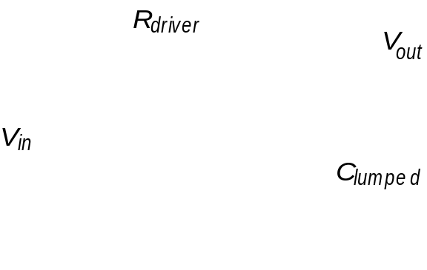
The Lumped Model
C_{wire} is
the capacitance
per unit length
Ideal model assuming the same voltage at every segment
C_{lumped} =C_{wire}x L

Slide 40
Calculating the Delay
Metal wires more than few millimeters have significant resistance
The lumped capacitor model is no longer adequate
Resistive capacitor model have to be adopted

Slide 41
Lumped R-C model
The capacitive lumped model is simple and most popular
On chip the wires are few millimeters in length and have significant resistance
We first look at the lumped RC model

Slide 42
Lumped RC model
The first Approach is lump the total wire resistance of each wire into single resistance
Similarly combines the global capacitances into single capacitance

Slide 43
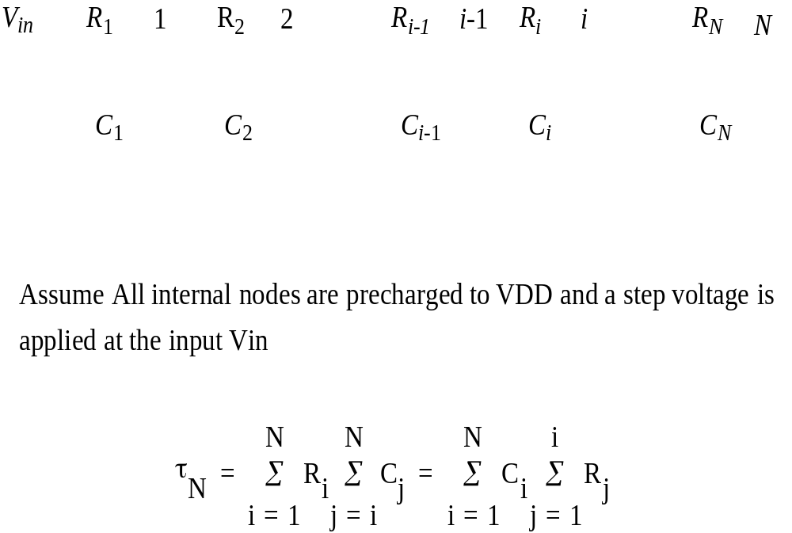
Elmore Delay
Lumped Model Non - Branched RC
Τ_{Di} = C₁R₁+ C₂( R₁+ R₂) + … + C_{i}( R₁+ R₂+…R_{i})

Slide 44
Time Constant RC Wire model
Distributed RC
The model can be used to approximate the RC delay in long wire
Assume wire with total length L partitioned into equal segments N, segment length L/N
The resistance will be rL/N, capacitance will be cL/N, where r and c are per unit length
Using Elmore model page 155( in Rabaey) to get the total delay

Slide 45
Time Constant RC Wire model
Distributed RC

Slide 46
The Model Presented on Page 43
can be used to approximate the resistance capacitive wire
The wire with total length of L is partitioned into N identical segmentseach with L/N length

Slide 47
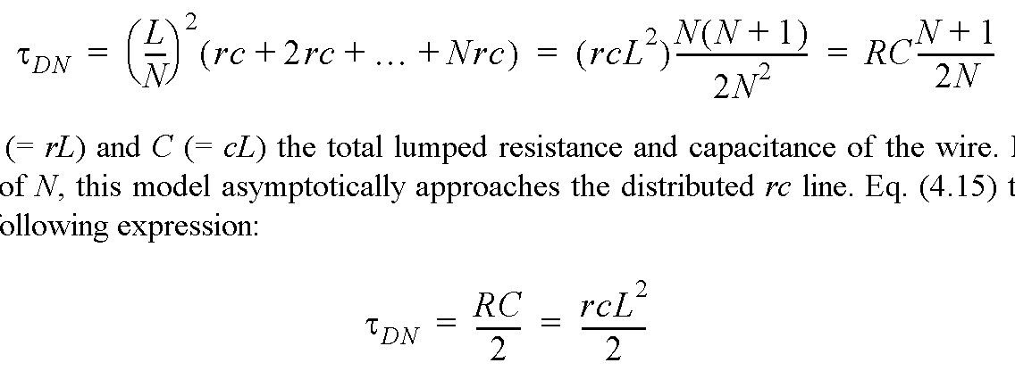
Distributed Wire Model
Assume: Wire modeled by N equal-length segments
R= rL
C = cL
For large values of N:

Slide 48
Time Constant RC Wire model
From the above Formula we see that the delay is quadratic function of the length L
The delay of the distributed rc line is one half the lumped model
Lumped RC model is pessimistic model for RC wire as compared to distributed model
The distributed model is more appropriate

Slide 49
Distributed rc line
In the previous discussion we showed that the RC model is a pessimistic model for the resistive –capacitive wire, and distributed rc model is more appropriate

Slide 50
Distributed rc Line
r is resistance per unit length, c is capacitance per unit length
The schematic representation is as shown
The correct behavior is obtained by the diffusion equation

Slide 51
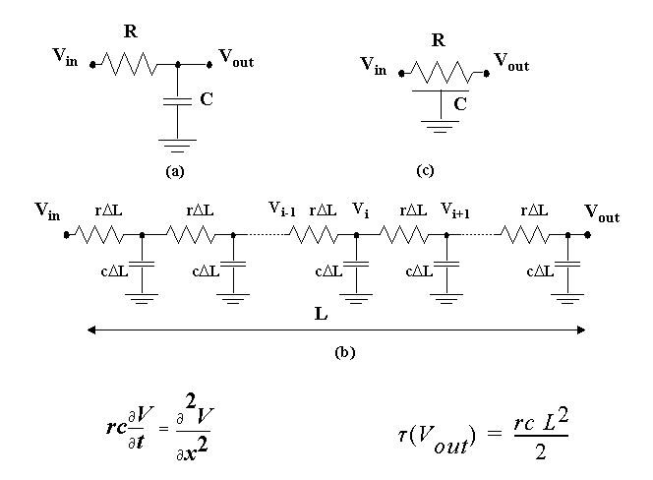
The Distributed RC-line
The diffusion equation
It can be represented by diffusion equation

Slide 52
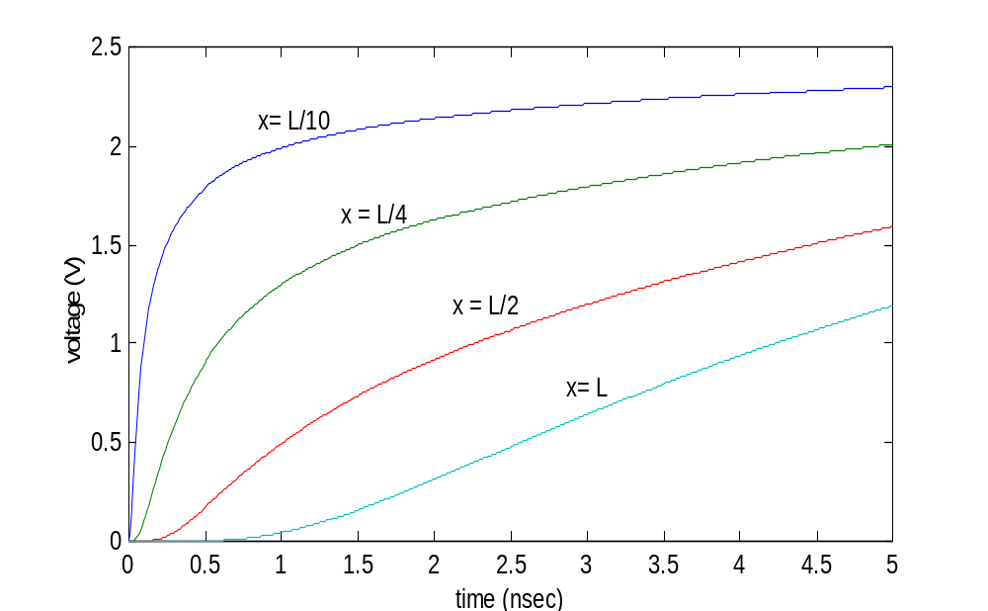
Simulation of Step-response of RC wire as a function of time
Solution of the Differential Equation as function of time and place
The waveform rapidly degrades for long wires

Slide 53
The Previous Figure
Shows the response of a wire to step input
Plotting the wave forms at different points in the wire as a function of time
Observe the step waveform diffuse from the start to the end of the wire, and the waveform rapidly rapidly degrades

Slide 54

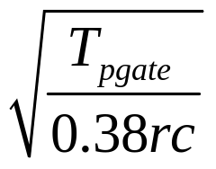
Design Rules of Thumb
Table 4-7 ( page 158-Rabaey) shows the delay of Lumped and distributed RC networks
rc delays should only be considered when t_{pRC} >> t_{pgate} of the driving gate
Time delay 0.69% lumped and 0.38RC distributed Voltage 0-50% voltage range drop
This will define critical length of the wire
0.38RC >> t_{pgate}
Lcrit >>
R = rL, and C = c L
rc delays should only be considered when the rise (fall) time at the gate input is smaller than RC, the rise (fall) time of the line
  t_{rise} < RC

Slide 55
Design Rule
When the designer analyze the interconnect network –to consider the effect of the RC delay and if it will be considered or can get away with a simple lumped capacitive model
Simple rule
rc delays should be considered only when t_{pRC}
is comparable or larger than t_{pgate} of the driving gate

Slide 56
Transmission line
When the switching speeds become sufficiently fast the inductance of the wire starts to dominate the delay behavior and transmission line effect must be considered
TR line effect must be already considered for deep submicron ( Technology Now ) designs
Transmission line effect should be considered when the rise and the fall time of the input signal is smaller than the time of flight of the transmission line

Slide 57
Summary
We will not discuss section 4.4.5 Transmission line in Rabaey book
The simulation tools should calculate the wire parasitic
This chapter presented in depth analysis of the behavior of the interconnect wire
One should always differentiate between global interconnection and local( what is local and Global interconnect)
Constant delay is predicted for local wire, while for global wire it increases 50% per year
Wire delay is starting to play a predominant role in today digital design

Slide 58
CMOS Inverter
Chapter 5
ECE6140/6240
Fall 2022

Slide 59
The CMOS Inverter: A First Glance
V
DD
V
V
in
out
C
L

Slide 60
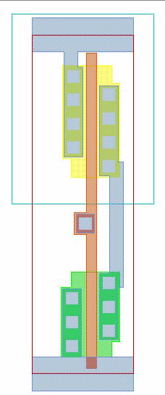
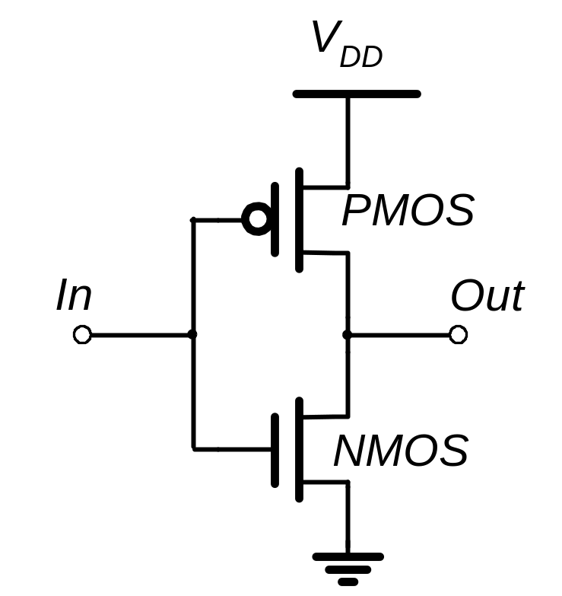
CMOS Inverter
N Well
V
DD
PMOS
2λ
Contacts
In
Out
Metal 1
Polysilicon
NMOS
GND

Slide 61
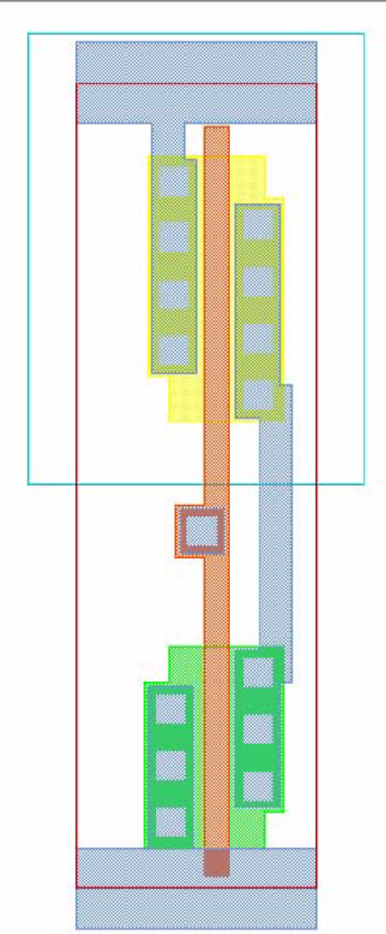
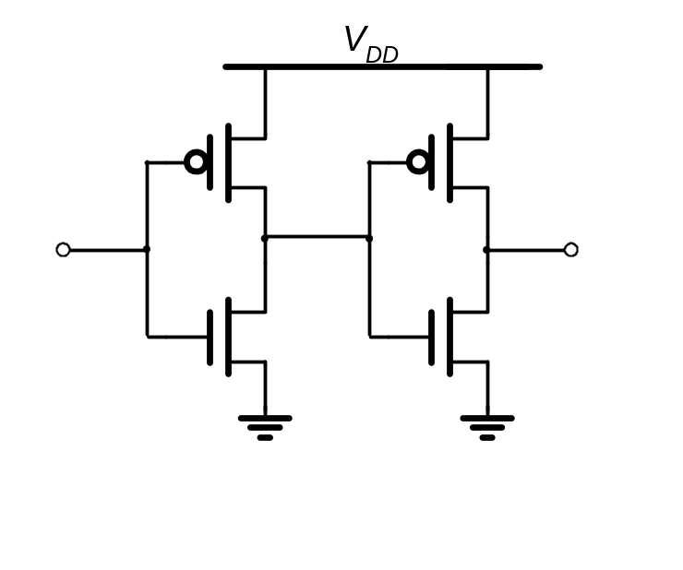
Two Inverters
Share power and ground
Abut cells
Connect in Metal

Slide 62
CMOS Inverter
First-Order DC Analysis
V
DD
V
DD
V_{OL} = 0
V_{OH} = V_{DD}
V_{M} = f(R_{n}, R_{p})
R
p
V
out
V
out
R
n
Switch model of
CMOS inverter
V
in
=
V
DD
V
in
=
0

Slide 63
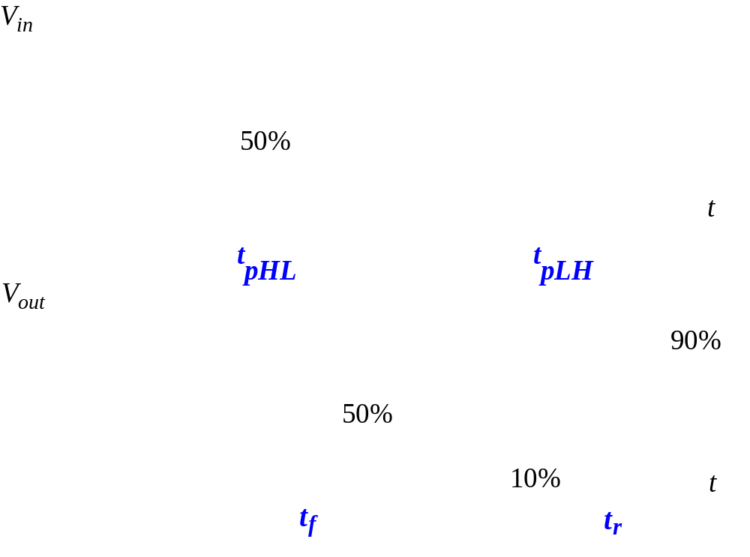
Delay Definitions

Slide 64
Important Reference Points
Propagation delay Τ_{p} defined as 50% of final voltage value
T_{p} is calculated as .38RC ( distributed) and .69RC ( Lumped)
Rise time T_{r} is the time to reach 90% of the final voltage
Fall time T_{f} is the time to reach 10% of the final voltage
( these results are from applying step response to lumped and distributed RC circuit)

Slide 65
Delay Estimation
We would like to be able to easily estimate delay
  Not as accurate as simulation
  But easier to ask “What if?”
The step response usually looks like a 1st order RC response with a decaying exponential.
Use RC delay models to estimate delay
  C = total capacitance on output node
  Use effective resistance R
  So that t_{pd} = RC
Characterize transistors by finding their effective R
  Depends on average current as gate switches

Slide 66
Properties
The logic levels at the output are not dependent on the relative sizes of the transistors, transistors can be minimum size
There is always a path from power supply or Ground to output. Well designed inverter have low output impedance less noise
The input resistance of the CMOS inverter is extremely high

Slide 67
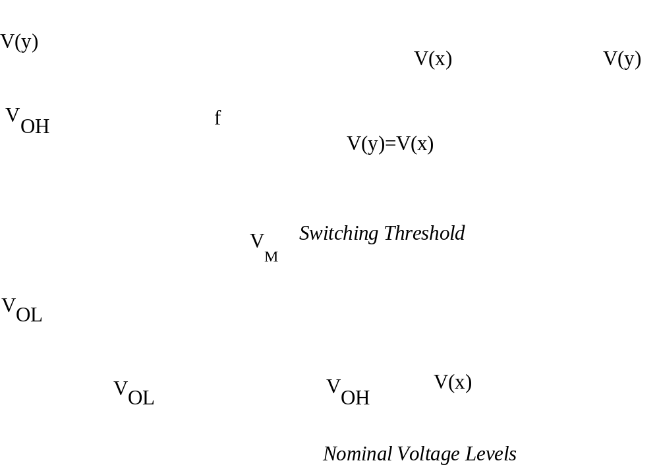
DC Operation:
Voltage Transfer Characteristic

Slide 68
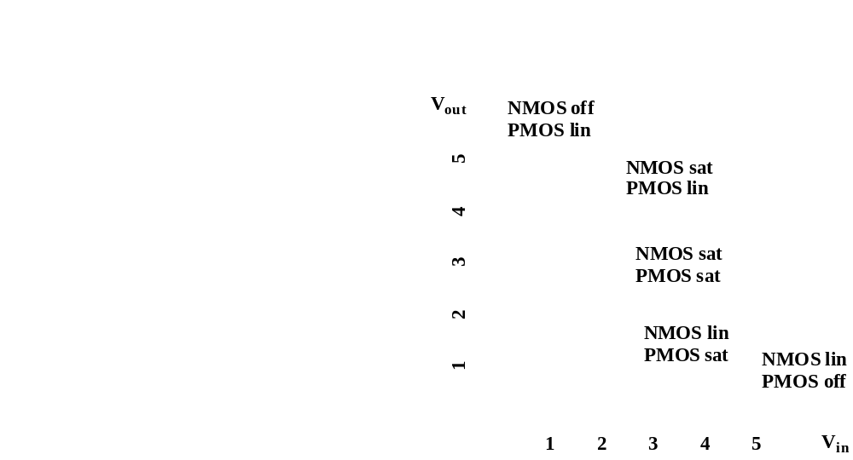
CMOS Inverter VTC

Slide 69
CMOS Inverter Region of Operation
0< V_{in}< V_{Th} , p-Linear, n-Off
V_{TH} < V_{in} < V_{DD}/2, p-linear,n-Sat
V_{in} = V_{DD}/2 , P-Sat, n- Sat
V_{DD}/2 < V_{in}< V_{DD}- V_{TH}, P-Sat, n-Linear
V_{in}> V_{DD} – V_{TH} , P-Off, n-Linear

Slide 70
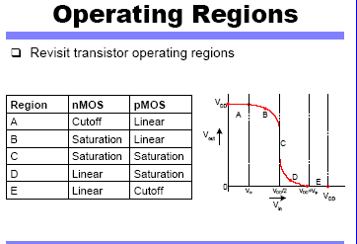

Slide 71
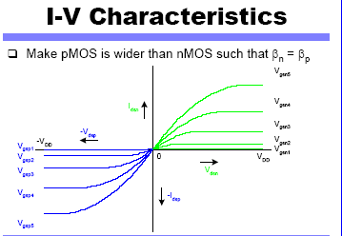

Slide 72
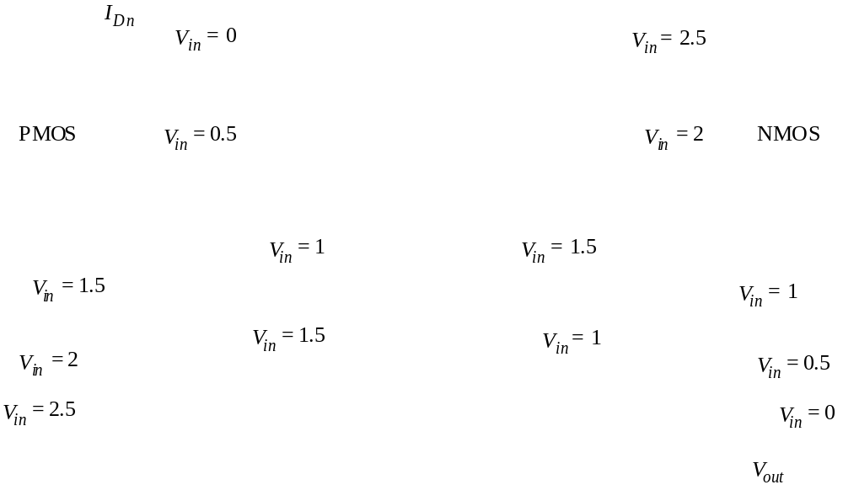
CMOS Inverter Load Characteristics

Slide 73
CMOS Inverter: Transient Response
V
DD
V
DD
R
t
pHL
= f(R
on
.C
L
)
p
= 0.69 R
on
C
L
V
out
V
out
C
L
C
L
R
n
Switch model of
Dynamic Behavior
of CMOS inverter
V
in
5
0
V
in
5
V
DD
(a) Low-to-high
(b) High-to-low

Slide 74
Gate Response
The fast gate is built either by keeping the output capacitance small or by decreasing the on-resistance of the transistor
The resistance is inversely proportion to W/L ratio, to decrease resistance increase W/L

Slide 75
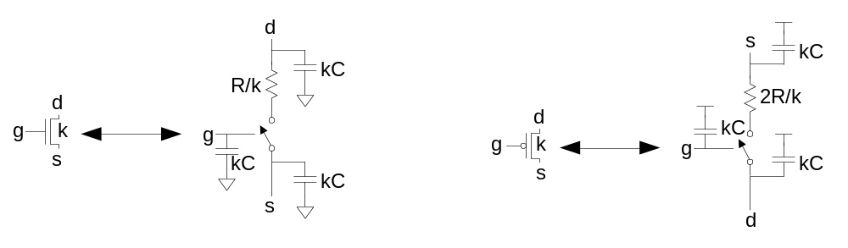
RC Delay Model
Use equivalent circuits for MOS transistors
  Ideal switch + capacitance and ON resistance
  Unit nMOS has resistance R, capacitance C
  Unit pMOS has resistance 2R, capacitance C
Capacitance proportional to width
Resistance inversely proportional to width
5: DC and Transient Response

Slide 76
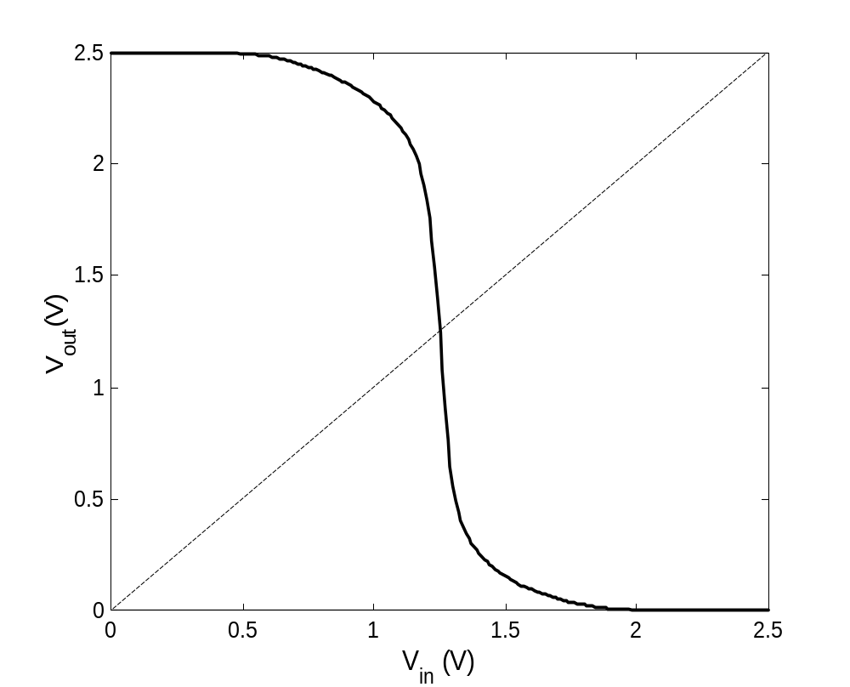
Simulated VTC ( voltage Transfer characteristics )
V m is the Switching Threshold

Slide 77
Switching Threshold
V_{M} is the switching threshold the point at which V_{in} = V_{out}
At this region both PMOS and NMOS are in saturation
Analytical expression is obtained by equating the current through the two devices

Slide 78
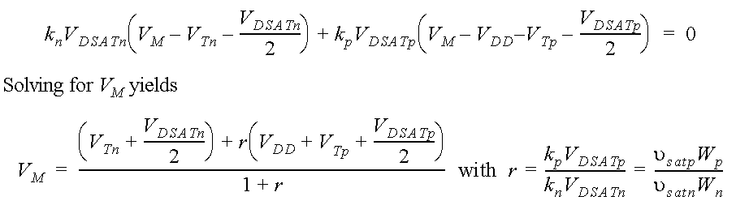
Switching Threshold as a function of Transistor Ratio
1.8
1.7
1.6
1.5
1.4
(V)
1.3
V
M
1.2
1.1
1
0.9
0.8
0
1
10
10
W
p
/W
n

Slide 79
Switching Threshold
V_{M} is relatively insensitive to variations of device ratio W/L
The effect of changing W_{p} to W_{n} is to shift the VTC, increasing the width of PMOS or the NMOS moves V_{M} toward V_{DD} or toward ground, this is sometime is useful

Slide 80
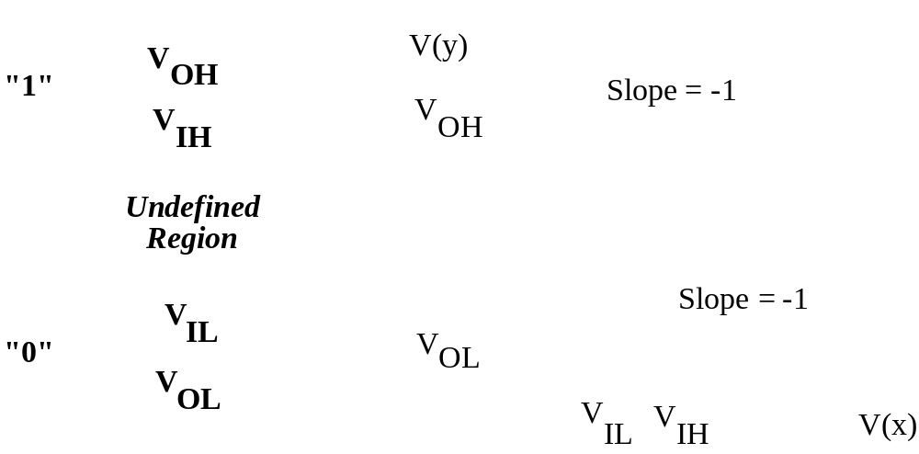
Mapping between analog and digital signals
Simple approach to
Approximate VTC
M.E.Zaghloul

Slide 81
Piecewise Linear Approximation of VTC
V_{OUT}
V_{OH}
Slope is g
Inverter is amplifier
With gain -g
V_{M}
V_{OL}
V_{IN}
V_{IL}
V_{IH}

Slide 82
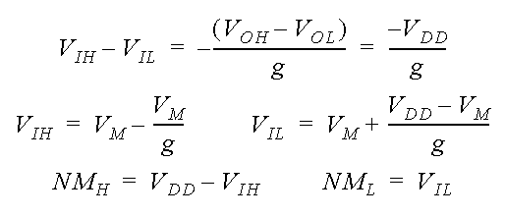
Noise Margin
Determining V_{IH} and V_{IL}
Simple PWL Model
g is the gain
g = -dVout/dVin
A simplified approach to VTC slope of the line is -g

Slide 83
Mapping between analog and digital signals
Simple approach to
Approximate VTC
M.E.Zaghloul

Slide 84
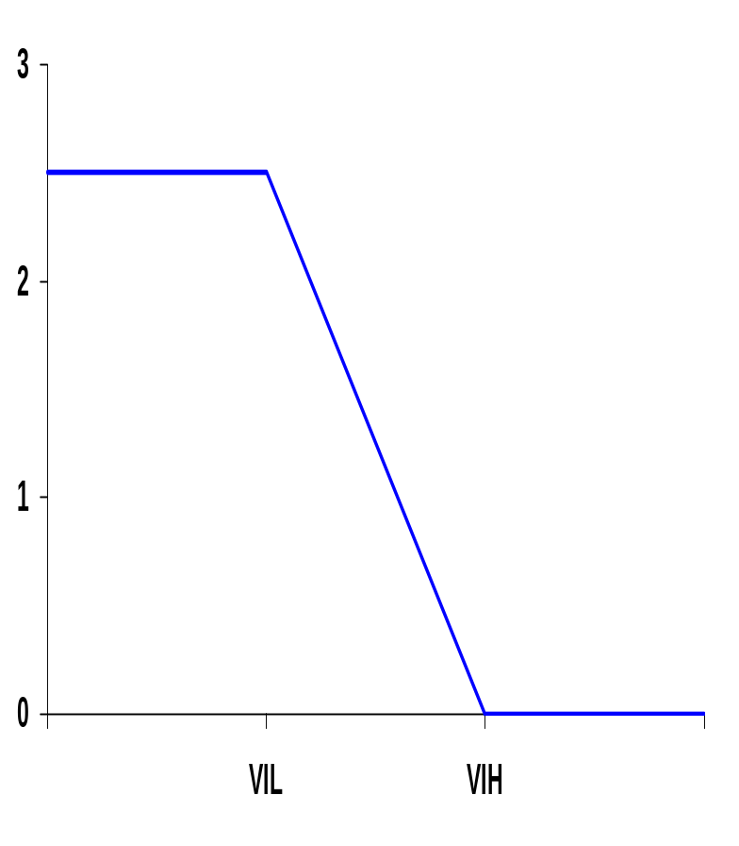
Noise Margins Determining V_{IH} and V_{IL}
By definition, V_{IH} and V_{IL} are where dV_{out}/dV_{in} = -1 (= gain)
V_{OH} = V_{DD}
NM_{H} = V_{DD} - V_{IH}
NM_{L} = V_{IL} - GND
Approximating:
V_{IH} = V_{M} - V_{M} /g
V_{IL} = V_{M} + (V_{DD} - V_{M} )/g
So high gain in the transition region is very desirable
V_{out}
V_{M}
V_{OL} = GND
V_{in}
A piece-wise linear approximation of VTC
M.E.Zaghloul
Notes:
A high gain in the transition region is VERY desirable. In the extreme case of an infinite gain, the noise margins simplify to VOH – VM and VM – VOL for NMH (ideally, VDD – VM) and NML (ideally, VM – GND), respectively, and span the complete voltage swing.

Slide 85
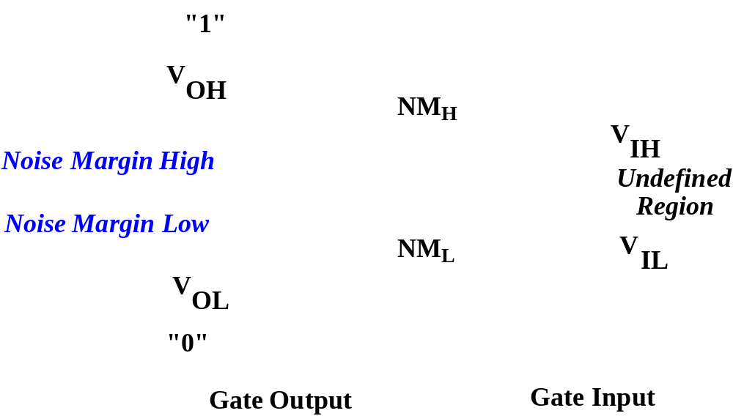
Definition of Noise Margins
M.E.Zaghloul

Slide 86
The gain of the Inverter
The midpoint gain at which the PMOS and NMOS are in saturation
The gain is dV_{out} / dV_{in}
Obtain the equation for V_{out} as function of V_{in} by equating the current at the switching voltage and considering the channel modulation

Slide 87
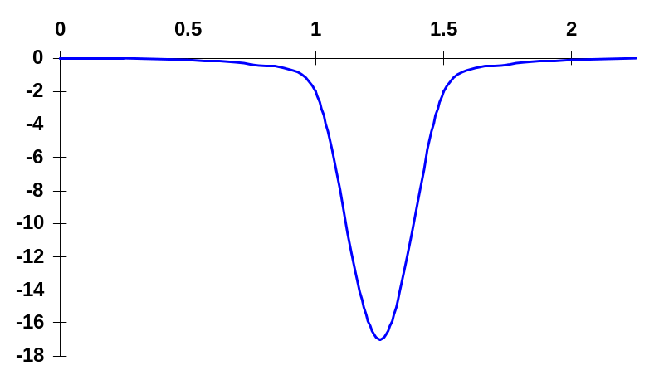
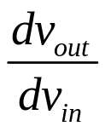
Gain Determinates
V_{in}
Gain is a strong function of the slopes of the currents in the saturation region, for V_{in} = V_{M}
Determined by technology parameters, especially channel length modulation (λ).
gain
Obtain the current equation for PMOS and NMOS, assuming devices in velocity saturation, and considering channel modulation
Gain g =
M.E.Zaghloul

Slide 88
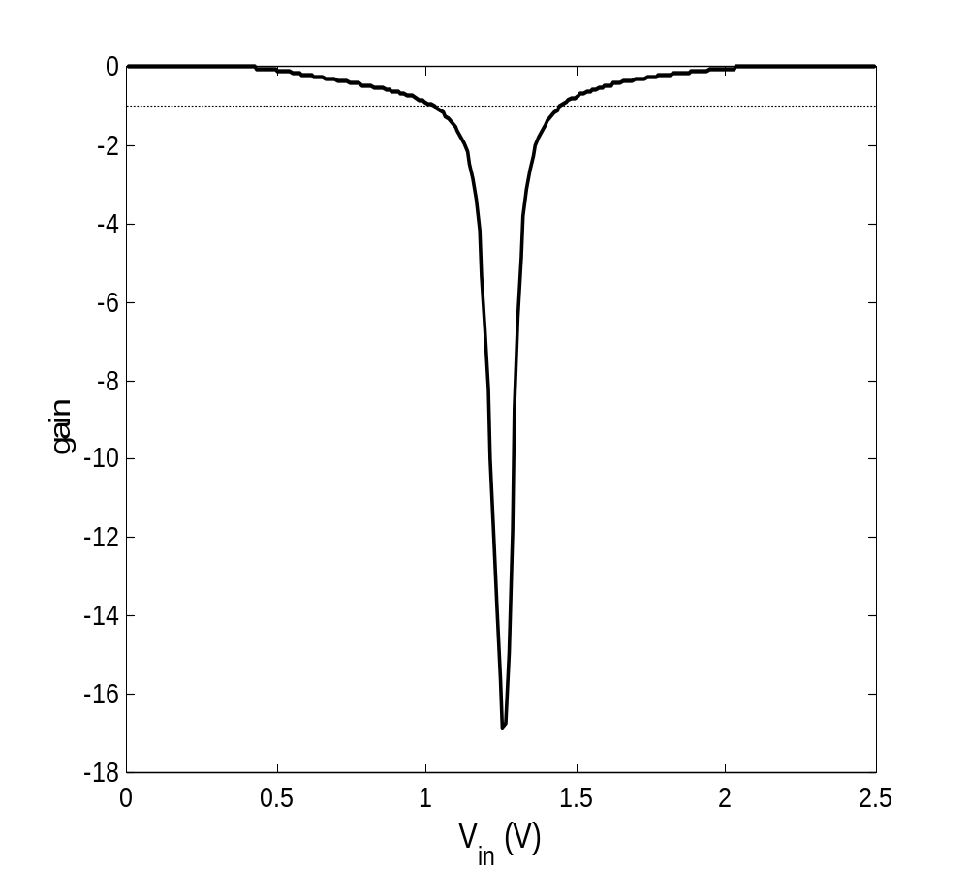
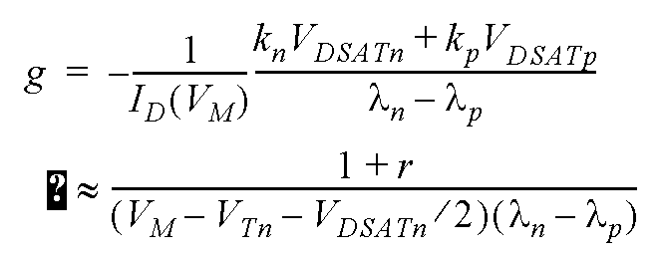
Inverter Gain

Slide 89
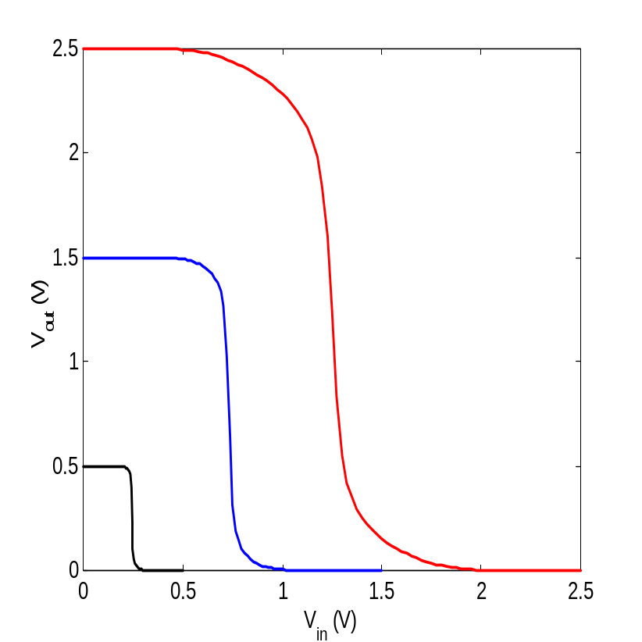
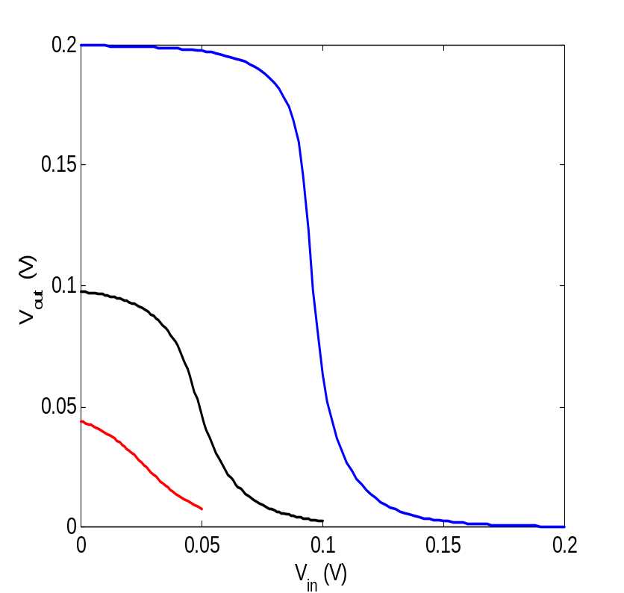
Gain as a function of VDD
Gain=-1
Reducing voltage VDD improves gain
It is worse for very low power supply

Slide 90
Scaling Power Supply
Reducing power supply reduce power (good) how about the delay?
The DC characteristics become sensitive to variations in the device parameters such as threshold voltage
Reducing supply voltage means reducing noise (internal noise) , circuit is more sensitive to external noise

Slide 91
Impact of Process Variations
2.5
2
Good PMOS
Bad NMOS
1.5
(V)
Nominal
out
Good NMOS
Bad PMOS
V
1
0.5
0
0
0.5
1
1.5
2
2.5
V
(V)
in

Slide 92
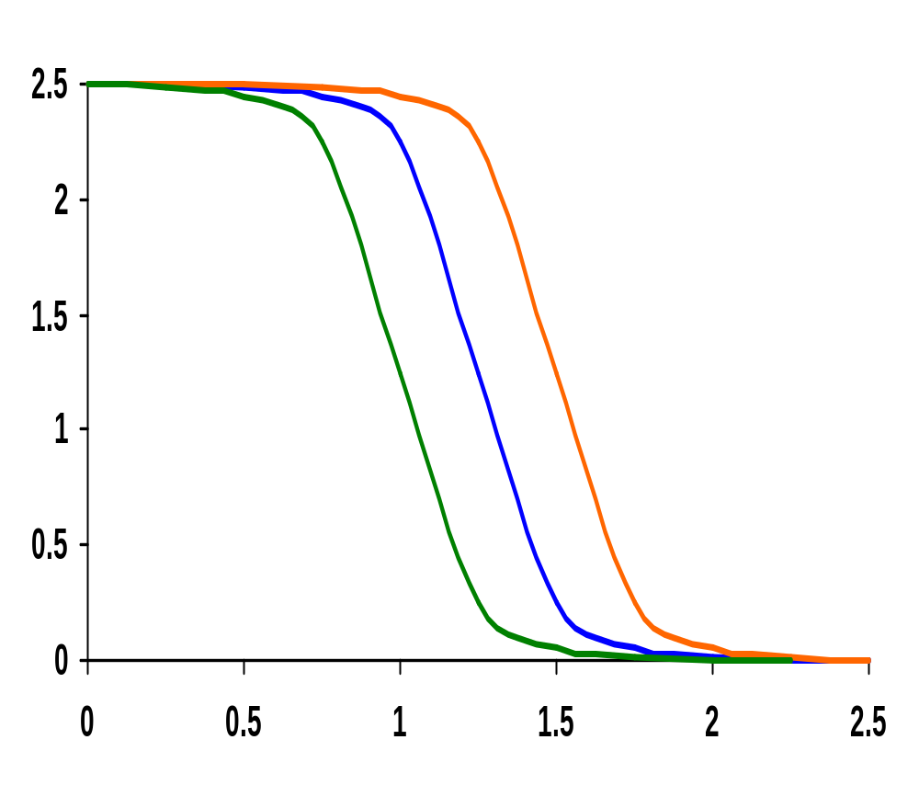
Impact of Process Variation on VTC Curve
Good PMOS
Bad NMOS
Smaller oxide
Thickness, Smaller
Length, Width
V_{out} (V)
Nominal
Bad PMOS
Good NMOS
V_{in} (V)
Process variations (mostly) cause a shift in the switching threshold
M.E.Zaghloul
Notes:
A good device has a small oxide thickness (-3nm), a small length (-25nm), a higher width (+30nm) and a smaller threshold (-60mV). The opposite is true for a bad device.

Slide 93
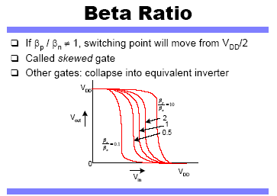

Slide 94
Dynamic Behavior of Inverter
Time Delay and Power
Next Class

